Slide 1
EPFL Space Center eSpace
Space Propulsion ENG-510

Slide 2
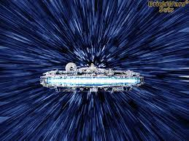
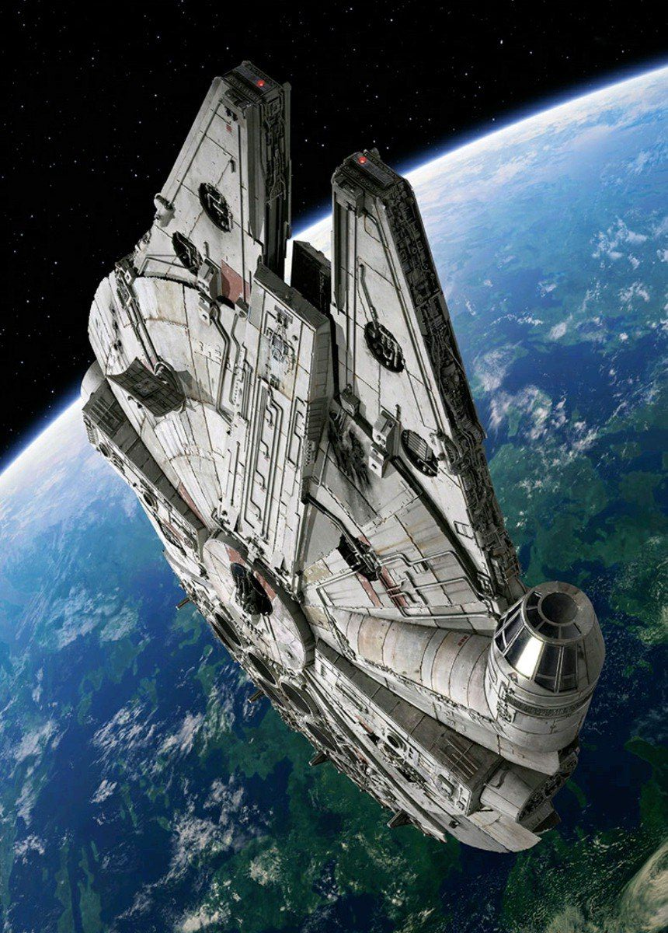
Lecture # 3 Introduction & General Course Information
Brief information on your lecturer and the space propulsion course

Slide 3
Project Outline
Exercise Description:
Exercise # 3 (due date on 23.3.2025): Performance Analysis
1-pager with the performance analysis of your Water rocket including theoretical description of the equations involved
Presentation of analysis results including graphs like altitude over time, speed over time, mass over time, pressure over time
Description of payload separation system + performance
Evaluation on 25.3.2025
To provide more details on the ground I/F (for some groups)
L3 - Introduction
Space Propulsion ENG-510

Slide 4
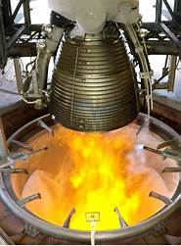
Lecture # 3 Part # 3 Introduction in Propulsion Systems
Brief overview on all space propulsion systems

Slide 5
What is the principle of Space Propulsion?
Space Propulsion:
Space propulsion or better in-space propulsion exclusively deals with propulsion systems used in the vacuum of space
(In-space propulsion should not be confused with space launch or atmospheric re-entry)
In that sense space or spacecraft propulsion is any method used to accelerate spacecraft / satellites by ejection of material
So the basic working principle in its simplest form, is a system that accelerates matter to provide a force of thrust that moves or rotates a vehicle
L3 – Propulsion Systems
Space Propulsion ENG-510

Slide 6
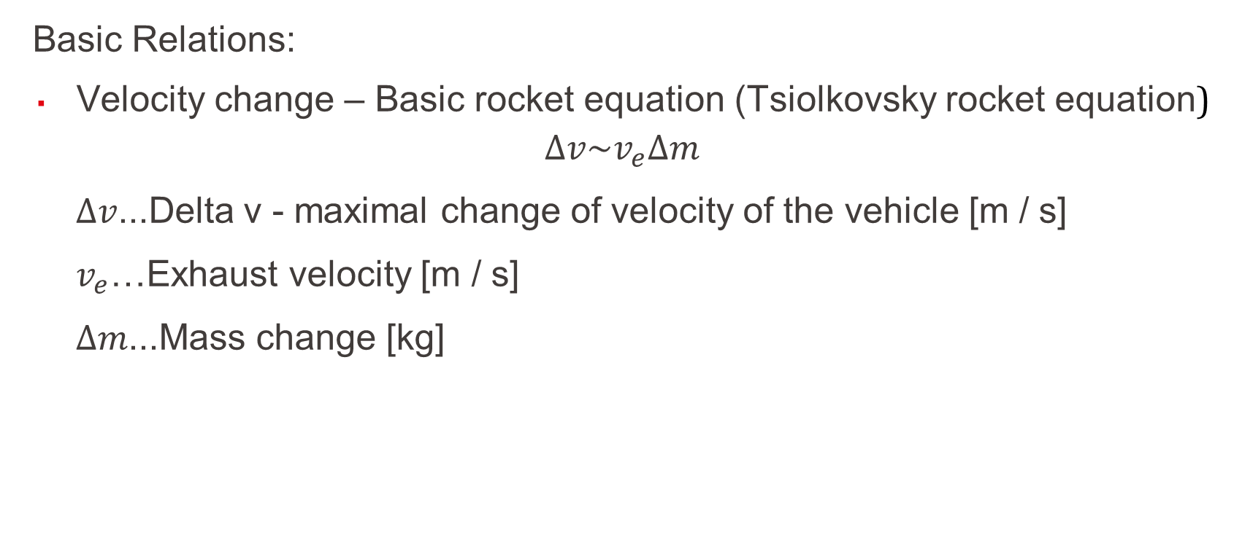
What is the principle of Space Propulsion?
Basic Relations:
Velocity change – Basic rocket equation (Tsiolkovsky rocket equation)
$$∆v\sim v_{e}∆m$$
$∆v$...Delta v - maximal change of velocity of the vehicle [m / s]
$v_{e}$…Exhaust velocity [m / s]
$∆m$...Mass change [kg]
L3 – Propulsion Systems
Space Propulsion ENG-510

Slide 7
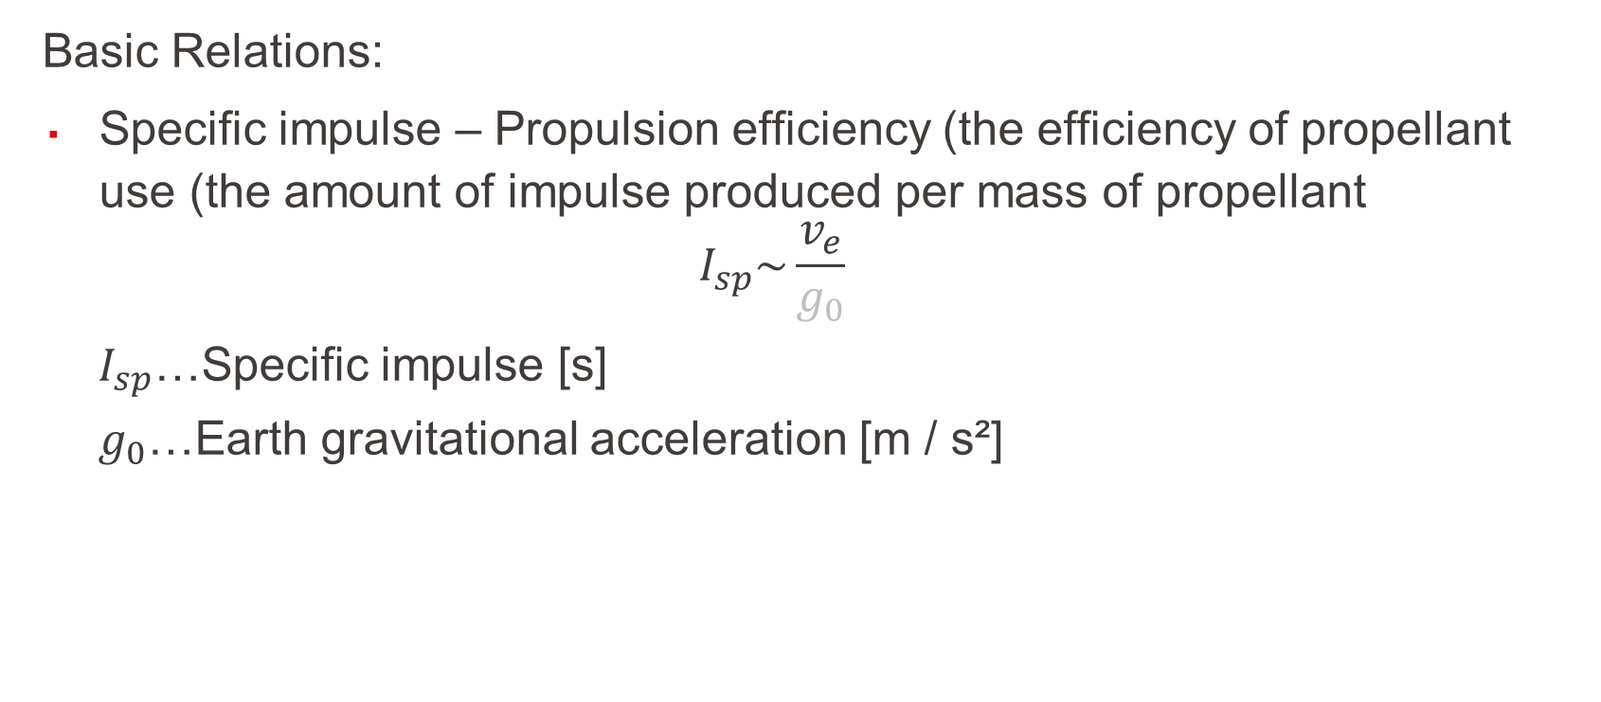
What is the principle of Space Propulsion?
Basic Relations:
Specific impulse – Propulsion efficiency (the efficiency of propellant use (the amount of impulse produced per mass of propellant
$$I_{sp}\sim \frac{v_{e}}{g_{0}}$$
$I_{sp}$…Specific impulse [s]
$g_{0}$…Earth gravitational acceleration [m / s²]
L3 – Propulsion Systems
Space Propulsion ENG-510

Slide 8
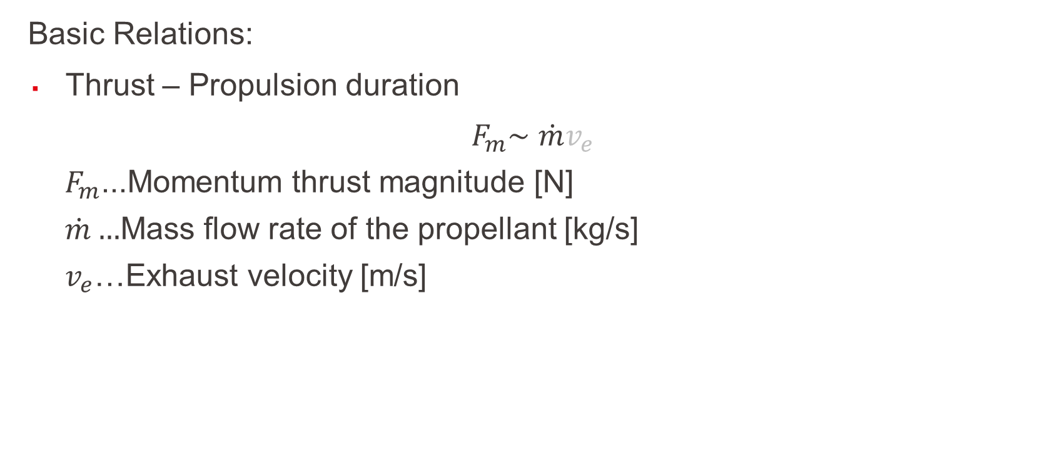
What is the principle of Space Propulsion?
Basic Relations:
Thrust – Propulsion duration
$F_{m}\sim$ ${\dot{m}v}_{e}$
$F_{m}$...Momentum thrust magnitude [N]
$\dot{m}…$Mass flow rate of the propellant [kg/s]
$v_{e}$…Exhaust velocity [m/s]
L3 – Propulsion Systems
Space Propulsion ENG-510

Slide 9
Which Propulsion Systems do we know?
Objective: To categorize different space propulsion systems
Space propulsion / in-space propulsion / towards space propulsion – Everything that accelerates a vehicle (launcher, rocket, satellite, orbital vehicle) by ejection of material but also…
Non-ejection systems that accelerates a vehicle like solar sails
L3 – Propulsion Systems
Space Propulsion ENG-510

Slide 10
Which Propulsion Systems do we know?
Objective: To categorize different space propulsion systems
Material Ejection
L3 – Propulsion Systems
Space Propulsion
Space Propulsion ENG-510
Non-Material Ejection

Slide 11
Which Propulsion Systems do we know?
Objective: To categorize different space propulsion systems
Material and Acceleration:
Material needs to be exhausted (which is already given by pressure difference between storage reservoir and space vacuum)
Material needs to be accelerated as much as possible to increase efficiency
L3 – Propulsion Systems
Space Propulsion ENG-510
Acceleration
Orifice
Mass
Impulse

Slide 12
Which Propulsion Systems do we know?
Objective: To categorize different space propulsion systems
Propulsion systems are categorized in this course w.r.t. acceleration principle:
Acceleration by thermal heating or cooling
Acceleration by chemical reaction
Acceleration by electrostatic fields or electromagnetic fields
L3 – Propulsion Systems
Space Propulsion ENG-510

Slide 13
Which Propulsion Systems do we know?
Objective: To categorize different space propulsion systems
Thermal Propulsion Systems
A thermal propulsion system is a system that ejects a propellant that is externally heated before being passed through a nozzle to produce thrust at a high medium velocity (as opposed to being internally heated by a combustion reaction as in a chemical propulsion system) or that is cooled down by expansion before being passed through a nozzle to produce at a small exhaust velocity
Thermal rockets can theoretically give high performance, depending on the fuel used and design specifications
Today the simple cold gas thruster is widely used for attitude control
L3 – Propulsion Systems
Space Propulsion ENG-510

Slide 14
Which Propulsion Systems do we know?
Objective: To categorize different space propulsion systems
Thermal Propulsion Systems
For a space propulsion system, the efficiency of propellant use (the amount of impulse produced per mass of propellant) is measured by the specific impulse which is proportional to the effective exhaust velocity
For thermal propulsion systems, the specific impulse increases as the square root of the temperature, and inversely as the square root of the molecular mass of the exhaust
In the simple case where a thermal source heats an ideal monatomic gas reaction mass, the maximum theoretical specific impulse is directly proportional to the thermal velocity of the heated gas
L3 – Propulsion Systems
Space Propulsion ENG-510

Slide 15
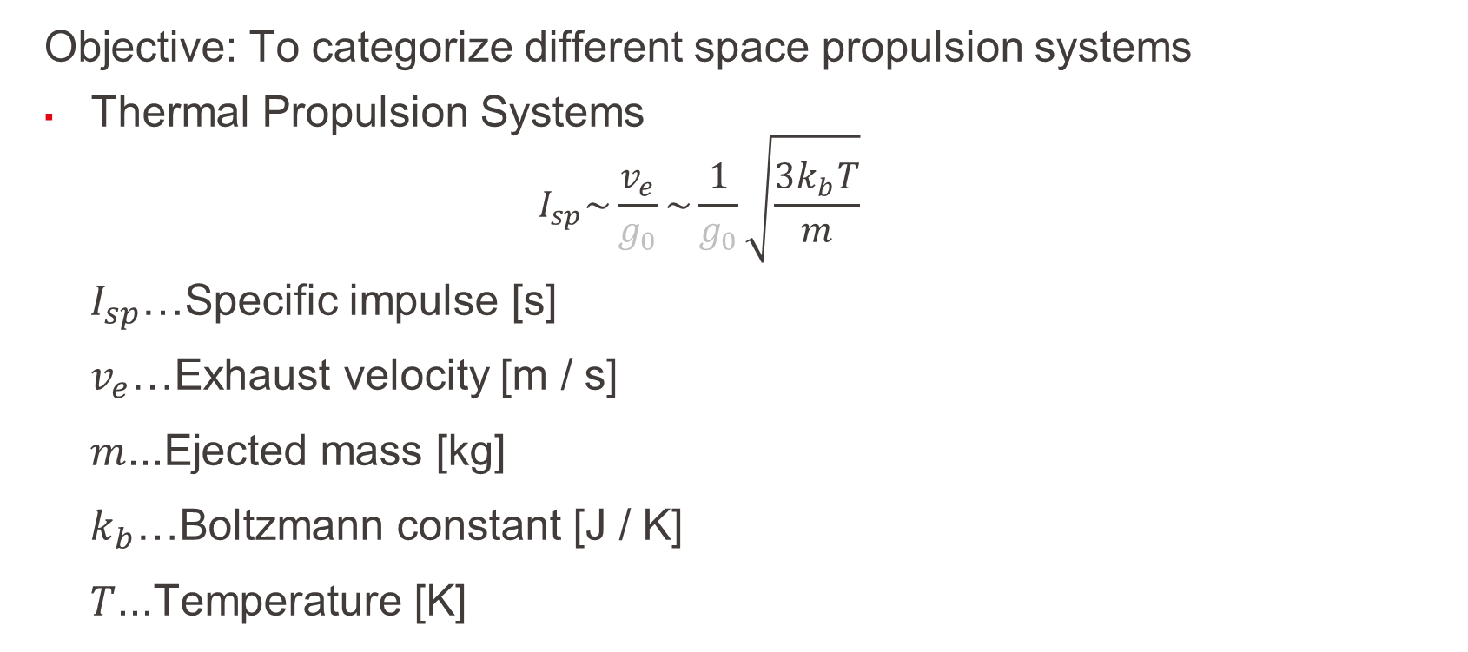
Which Propulsion Systems do we know?
Objective: To categorize different space propulsion systems
Thermal Propulsion Systems
$$I_{sp}\sim \frac{v_{e}}{g_{0}}\sim \frac{1}{g_{0}}\sqrt{\frac{3k_{b}T}{m}}$$
$I_{sp}$…Specific impulse [s]
$v_{e}$…Exhaust velocity [m / s]
$m$...Ejected mass [kg]
$k_{b}$…Boltzmann constant [J / K]
$T$...Temperature [K]
L3 – Propulsion Systems
Space Propulsion ENG-510

Slide 16
Which Propulsion Systems do we know?
Objective: To categorize different space propulsion systems
Chemical Propulsion Systems
Chemical propulsion systems obtain the energy needed to generate thrust by ‘internal’ chemical reactions to create a hot gas that is expanded (through a nozzle) to produce thrust with a medium exhaust velocity
Many different propellant combinations are used to obtain these chemical reactions, including, for example, hydrazine, liquid oxygen, liquid hydrogen, nitrous oxide and hydrogen peroxide
Propellants can be used as a monopropellant or in bi- respectively tri-propellant configurations
L3 – Propulsion Systems
Space Propulsion ENG-510

Slide 17
Which Propulsion Systems do we know?
Objective: To categorize different space propulsion systems
Electrical Propulsion Systems
In contrast to chemical propulsion systems, electric propulsion systems use electrostatic or electromagnetic fields to accelerate a charged propellant
The benefit of this method is that the acceleration of a charged propellant by electric fields can achieve very high exhaust velocities, up to 10 times greater than those of a chemical engine, producing steady thrust with far less fuel
L3 – Propulsion Systems
Space Propulsion ENG-510

Slide 18
Which Propulsion Systems do we know?
Objective: To categorize different (most relevant) space propulsion systems
Thermal Propulsion Systems
Material Ejection
L3 – Propulsion Systems
Space Propulsion
Space Propulsion ENG-510
Chemical Propulsion Systems
Non-Material Ejection
Electrical Propulsion Systems

Slide 19
Which Propulsion Systems do we know?
Objective: To categorize different (most relevant) space propulsion systems
Thermal Propulsion Systems
Material Ejection
L3 – Propulsion Systems
Space Propulsion
Space Propulsion ENG-510
Chemical Propulsion Systems
Non-Material Ejection
Electrical Propulsion Systems

Slide 20
Which Thermal Propulsion Systems exist?
Objective: To develop the basics of thermal propulsion
Thermal Propulsion Systems
Cold gas propulsion systems
Cold gas / liquid propulsion systems (e.g. Water rocket…)
Solid powder / cold gas propulsion systems
Cryogenic boil-off propulsion systems
Liquefied gas propulsion systems
Steam (hot Water vapor) propulsion systems
Electrothermal propulsion systems
Solar thermal propulsion systems
Nuclear thermal propulsion systems
L3 – Propulsion Systems
Space Propulsion ENG-510

Slide 21
Which Thermal Propulsion Systems exist?
Objective: To develop the basics of thermal propulsion
Thermal Propulsion Systems – Group 1 – Acceleration principle by expansion leading to medium cool-down
Cold gas propulsion systems
Cold gas / liquid propulsion systems (e.g. Water rocket…)
Solid powder / cold gas propulsion systems
Cryogenic boil-off propulsion systems
Liquefied gas propulsion systems
Steam (hot Water vapor) propulsion systems
L3 – Propulsion Systems
Space Propulsion ENG-510

Slide 22
Which Thermal Propulsion Systems exist?
Objective: To develop the basics of thermal propulsion
Thermal Propulsion Systems – Group 2 – Acceleration principle by medium heating with electric power (+ expansion leading to medium cool-down)
Electrothermal propulsion systems
Thermal Propulsion Systems – Group 3 by medium heating with other power means (+ expansion leading to medium cool-down)
Solar thermal propulsion systems
Nuclear thermal propulsion systems
Laser thermal propulsion systems
Microwave thermal propulsion systems
Others…
L3 – Propulsion Systems
Space Propulsion ENG-510

Slide 23
Which Thermal Propulsion Systems exist?
Cold gas propulsion systems
Cold gas / liquid propulsion systems
Solid powder / cold gas propulsion systems
Objective: To develop the basics of thermal propulsion
Cryogenic boil-off propulsion systems
Acceleration by Expansion
L3 – Propulsion Systems
Thermal Propulsion Systems
Liquefied gas propulsion systems
Space Propulsion ENG-510
Acceleration by Electric Heat
Steam (hot Water vapor) propulsion systems
Resistojet Electrothermal Thruster
Acceleration by other Power Heat
Arcjet Electrothermal Thruster

Slide 24
Which Thermal Propulsion Systems exist?
Objective: To develop the basics of thermal propulsion
Acceleration by Expansion
Solar thermal propulsion systems
L3 – Propulsion Systems
Thermal Propulsion Systems
Nuclear thermal propulsion systems
Space Propulsion ENG-510
Acceleration by Electric Heat
Radioisotope thermal propulsion systems
Laser thermal propulsion systems
Acceleration by other Power Heat
Microwave thermal propulsion systems

Slide 25
Which Thermal Propulsion Systems exist?
Objective: To develop the basics of thermal propulsion
For group 2 and group 3 Thermal Propulsion Systems it is important to understand the power needed to increase especially the Isp to a higher value compared to a pure expansion acceleration principle
L3 – Propulsion Systems
Space Propulsion ENG-510

Slide 26
Which Thermal Propulsion Systems exist?
Objective: To develop the basics of thermal propulsion – Group 1
Description of Steam (hot Water vapor) Propulsion Systems:
A steam rocket (also known as a "hot water propulsion system") is a thermal propulsion system that uses water held in a pressure vessel at a high temperature, such that its saturated vapor pressure is significantly greater than ambient pressure
The water is allowed to escape as steam through a rocket nozzle to produce thrust
L2 – Propulsion Systems
Space Propulsion ENG-510

Slide 27
Which Thermal Propulsion Systems exist?
Objective: To develop the basics of thermal propulsion – Group 1
Description of Steam (hot Water vapor) Propulsion Systems:
Water, while under pressure, is heated up to a high temperature (approx. 250 to 500 °C)
As the hot water goes through the nozzle and the pressure reduces, the water flashes to steam pressing on the nozzle, and leaving at high speed
The nozzle of hot water thermal propulsion systems must be able to withstand high pressure, high temperatures and the particularly corrosive nature of hot water
The simplest design has a pressurized water tank where the water is heated
L2 – Propulsion Systems
Space Propulsion ENG-510

Slide 28
Which Thermal Propulsion Systems exist?
Objective: To develop the basics of thermal propulsion – Group 1
Characteristics of Steam (hot Water vapor) Propulsion Systems:
High degree of reliability
Very low exhaust velocity since the high latent heat of vaporization means that very little actual steam is produced and the exhaust consists mostly of water
If high temperatures and pressures are used, then the tank is very heavy
L2 – Propulsion Systems
Space Propulsion ENG-510

Slide 29

Which Thermal Propulsion Systems exist?
Objective: To develop the basics of thermal propulsion – Group 2
Acceleration by Electric Heat as for example in electrothermal thrusters (+ through expansion via a nozzle)
Resistojets: fluid warm-up with an electric resistance
Arcjets: fluid warm-up with an electric arc
L2 – Propulsion Systems
Space Propulsion ENG-510

Slide 30
Which Thermal Propulsion Systems exist?
Objective: To develop the basics of thermal propulsion
Acceleration by Expansion
L3 – Propulsion Systems
Thermal Propulsion Systems
Space Propulsion ENG-510
Acceleration by Electric Heat
Resistojet Electrothermal Thruster (~ 2 km/s)
Acceleration by other Power Heat
Arcjet Electrothermal Thruster (~ 8 km/s)

Slide 31
Which Thermal Propulsion Systems exist?
Objective: To develop the basics of thermal propulsion – Group 2
Electrothermal Thruster – Operations and Performance
Thrust generated by heating and acceleration of propellant through a nozzle
Hence specific impulse maximized for propellants with high specific heat and high temperature
High specific heat => low molecular weight
Low molecular weight gaseous propellants are more difficult to store (tank mass and volume scales approximately with inverse of molecular weight)
Trade of propellant mass gains against tank mass penalty
L2 – Propulsion Systems
Space Propulsion ENG-510

Slide 32
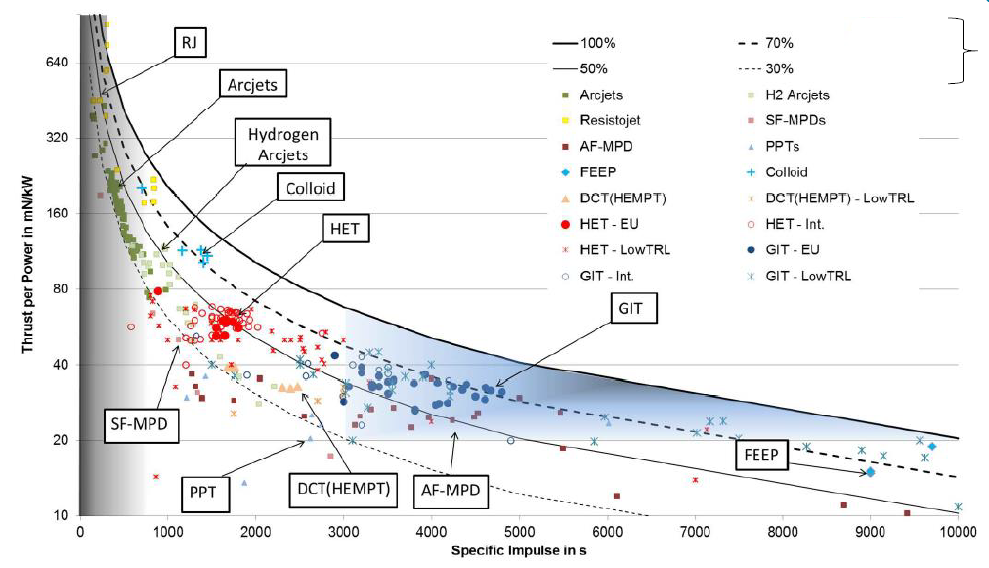
Which Thermal Propulsion Systems exist?
Objective: To develop the basics of thermal propulsion
Acceleration by Expansion
L3 – Propulsion Systems
Thermal Propulsion Systems
Space Propulsion ENG-510
Acceleration by Electric Heat

Slide 33
Which Thermal Propulsion Systems exist?
Objective: To develop the basics of thermal propulsion – Group 2
Resistojet thrusters
Resistojets are electrothermal devices in which the propellant is heated by passing through a resistively heated chamber or over a resistively heated element before entering a downstream nozzle
The increase in exhaust velocity is due to thermal heating of the propellant, which limits the Isp to rather low levels for an EP system (< 500 s)
L2 – Propulsion Systems
Space Propulsion ENG-510

Slide 34
Which Thermal Propulsion Systems exist?
Objective: To develop the basics of thermal propulsion – Group 2
Resistojet thrusters
Application: many
Working fluid: hot gas
Working fluid generation: resistive heating
Acceleration: nozzle
Exhaust velocity (typical): 1 – 5 km/s
Power (typical): 10 W – 2 kW
Temperatures: typically ~ 800 to 1500 K
L2 – Propulsion Systems
Space Propulsion ENG-510

Slide 35
Which Thermal Propulsion Systems exist?
Objective: To develop the basics of thermal propulsion – Group 2
Resistojet thrusters
Principle:
Electrical heaters instead of chemical combustion (no ionization)
Propellants:
Nearly all (Butane, Water, Xenon, Nitrogen, Hydrazine, Ammonia, Hydrogen)
Typical Isp:
50 s (Xe) to 300 (Hydrazine) @ 50 to 90 %
L2 – Propulsion Systems
Space Propulsion ENG-510

Slide 36
Which Thermal Propulsion Systems exist?
Objective: To develop the basics of thermal propulsion – Group 2
Resistojet thrusters
Advantages
Simpler design / configuration
Disadvantages
Performance efficiency is less compared to GIT (Gridded Ion Thruster)
L2 – Propulsion Systems
Space Propulsion ENG-510

Slide 37
Which Thermal Propulsion Systems exist?
Objective: To develop the basics of thermal propulsion – Group 2
Resistojet thrusters
L2 – Propulsion Systems
Space Propulsion ENG-510

Slide 38
Which Thermal Propulsion Systems exist?
Objective: To develop the basics of thermal propulsion – Group 2
Resistojet thrusters
L2 – Propulsion Systems
Space Propulsion ENG-510

Slide 39
Which Thermal Propulsion Systems exist?
Objective: To develop the basics of thermal propulsion – Group 2
Resistojet thrusters
EHT – Electrothermal hydrazine thrusters
Heats the decomposition products of a monopropellant hydrazine thruster to boost the specific impulse
Performance summary:
Specific impulse 290 to 300 s
150 to 800m N
Specific power typically 1 to 2 W/mN
Efficiencies apparently > 100 %; due to contribution from chemical energy released during decomposition
L2 – Propulsion Systems
Space Propulsion ENG-510

Slide 40
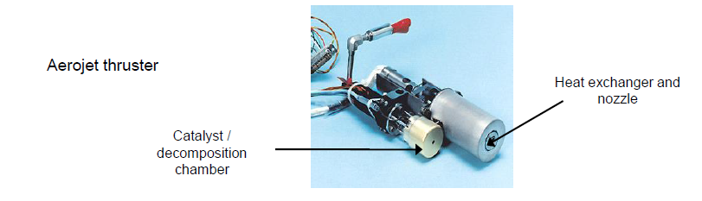
Which Thermal Propulsion Systems exist?
Objective: To develop the basics of thermal propulsion – Group 2
Resistojet thrusters
L2 – Propulsion Systems
Space Propulsion ENG-510

Slide 41
Which Thermal Propulsion Systems exist?
Objective: To develop the basics of thermal propulsion – Group 2
Arcjet thrusters
An arcjet is also an electrothermal thruster that heats the propellant by passing it though a high current arc in line with the nozzle feed system
As there is an electric discharge involved in the propellant path, plasma effects are insignificant in the exhaust velocity because the propellant is weakly ionized
The electrical discharge in the propellant flow adds energy to the propellant
Use either an inert propellant, or are combined with a monopropellant hydrazine thruster
Isp is therefore limited by the thermal heating to less than about 700 s for easily stored propellants
1994: First Arcjet used for operation on TELSTAR 401 (Martin Marietta)
L2 – Propulsion Systems
Space Propulsion ENG-510

Slide 42
Which Thermal Propulsion Systems exist?
Objective: To develop the basics of thermal propulsion – Group 2
Arcjet thrusters
Application: many
Working fluid: plasma
Working fluid generation: arc discharge
Acceleration: nozzle
Exhaust velocity (typical): 5 – 10 km/s
Power (typical): 1 – 2 kW
L2 – Propulsion Systems
Space Propulsion ENG-510

Slide 43
Which Thermal Propulsion Systems exist?
Objective: To develop the basics of thermal propulsion – Group 2
Arcjet thrusters
Principle:
Electric arc heats incoming gas up to several thousand degree (only little ionization is needed)
Propellants:
Lightweight (H2, He, N2H4, NH3)
Not amused about oxygen (erosion) and carbon (deposition)
Typical Isp:
600 s (Hydrazine) @ 30 to 40 %
L2 – Propulsion Systems
Space Propulsion ENG-510

Slide 44
Which Thermal Propulsion Systems exist?
Objective: To develop the basics of thermal propulsion – Group 2
Arcjet thrusters
Advantages:
Technology requiring low power (9 kW/N)
Drawbacks:
Limited specific Impulse
Erosion and Arc stability
L2 – Propulsion Systems
Space Propulsion ENG-510

Slide 45
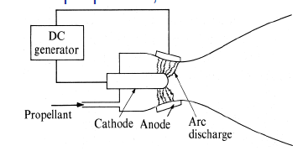
Which Thermal Propulsion Systems exist?
Objective: To develop the basics of thermal propulsion – Group 2
Arcjet thrusters
L2 – Propulsion Systems
Space Propulsion ENG-510

Slide 46
Which Thermal Propulsion Systems exist?
Objective: To develop the basics of thermal propulsion – Group 2
Arcjet thrusters
L2 – Propulsion Systems
Space Propulsion ENG-510

Slide 47
Which Thermal Propulsion Systems exist?
Objective: To develop the basics of thermal propulsion – Group 2
Arcjet thrusters
A
L2 – Propulsion Systems
Erosion
Deposition
Space Propulsion ENG-510

Slide 48
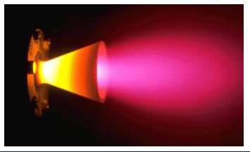
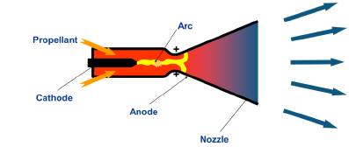
Which Thermal Propulsion Systems exist?
Objective: To develop the basics of thermal propulsion – Group 2
Arcjet thrusters
L2 – Propulsion Systems
Space Propulsion ENG-510

Slide 49
Which Thermal Propulsion Systems exist?
Objective: To develop the basics of thermal propulsion – Group 3
Acceleration by other power sources to heat propellant (+ through expansion via a nozzle)
L2 – Propulsion Systems
Space Propulsion ENG-510

Slide 50
Which Thermal Propulsion Systems exist?
Objective: To develop the basics of thermal propulsion – Group 3
Acceleration by Expansion
Solar thermal propulsion systems
L3 – Propulsion Systems
Thermal Propulsion Systems
Nuclear thermal propulsion systems
Space Propulsion ENG-510
Acceleration by Electric Heat
Radioisotope thermal propulsion systems
Laser thermal propulsion systems
Acceleration by other Power Heat
Microwave thermal propulsion systems

Slide 51
Which Thermal Propulsion Systems exist?
Objective: To develop the basics of thermal propulsion – Group 3
Description of solar thermal propulsion systems
A solar thermal rocket is a spacecraft propulsion system that would make use of solar power to directly heat reaction mass (propellant like Hydrogen), and therefore would not require an electrical generator, like most other forms of solar-powered propulsion do
The rocket would only have to carry the means of capturing solar energy, such as mirrors
The heated propellant would be fed through a conventional rocket nozzle to produce thrust
L2 – Propulsion Systems
Space Propulsion ENG-510

Slide 52
Which Thermal Propulsion Systems exist?
Objective: To develop the basics of thermal propulsion – Group 3
Description of solar thermal propulsion systems
Its engine thrust would be directly related to the surface area of the solar collector and to the local intensity of the solar radiation
In the shorter term, solar thermal propulsion has been proposed both for longer-life, lower-cost, more efficient use of the sun and more-flexible cryogenic upper stages
Solar thermal propulsion is also a good candidate for use in reusable inter-orbital tugs, as it is a high-efficiency low-thrust system that can be re-fueled with relative ease
L2 – Propulsion Systems
Space Propulsion ENG-510

Slide 53
Which Thermal Propulsion Systems exist?
Objective: To develop the basics of thermal propulsion – Group 3
Architecture of solar thermal propulsion systems
L2 – Propulsion Systems
Collector
Space Propulsion ENG-510
Tank
Exhaust
Regulator
Valve
R
Heating

Slide 54
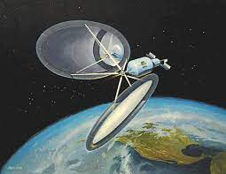
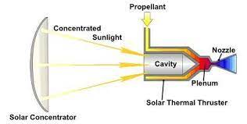
Which Thermal Propulsion Systems exist?
Objective: To develop the basics of thermal propulsion – Group 3
Solar thermal propulsion systems
L2 – Propulsion Systems
Space Propulsion ENG-510

Slide 55
Which Thermal Propulsion Systems exist?
Objective: To develop the basics of thermal propulsion – Group 3
Description of nuclear thermal propulsion systems
A nuclear thermal rocket (NTR) is a type of thermal rocket where the heat from a nuclear reaction (nuclear fission), replaces the chemical energy of the propellants in a chemical propulsion system
In an NTR, a working fluid (propellant), usually Liquid Hydrogen, is heated to a high temperature in a nuclear rocket and then expands through a rocket nozzle to create thrust
The external nuclear heat source theoretically allows a higher effective exhaust velocity and is expected to double or triple payload capacity compared to chemical propellants that store energy internally
L2 – Propulsion Systems
Space Propulsion ENG-510

Slide 56
Which Thermal Propulsion Systems exist?
Objective: To develop the basics of thermal propulsion – Group 3
Description of nuclear thermal propulsion systems
NTRs have been proposed as a spacecraft propulsion technology, with the earliest ground tests occurring in 1955
The USA maintained an NTR development program through 1973 when it was shut down to focus on Space Shuttle development
Although more than ten reactors of varying power output have been built and tested, as of 2021, no nuclear thermal rocket has flown
Further classification is the type of core: Solid, liquid or gas core
L2 – Propulsion Systems
Space Propulsion ENG-510

Slide 57
Which Thermal Propulsion Systems exist?
Objective: To develop the basics of thermal propulsion – Group 3
Nuclear thermal propulsion systems
In a nuclear thermal rocket a working fluid, usually liquid hydrogen, is heated to a high temperature in a nuclear reactor, and then expands through a nozzle to create thrust
The nuclear reactor's energy replaces the chemical energy of the reactive chemicals in a chemical propulsion system
Due to the higher energy density of the nuclear fuel compared to chemical fuels, the resulting specific impulse of the engine is at least twice as good as chemical engines
L2 – Propulsion Systems
Space Propulsion ENG-510

Slide 58
Which Thermal Propulsion Systems exist?
Objective: To develop the basics of thermal propulsion – Group 3
Nuclear thermal propulsion systems
A nuclear thermal propulsion system can be categorized by the type of reactor, ranging from a relatively simple solid reactor up to the much more difficult to construct but theoretically more efficient gas core reactor
As with all thermal propulsion system designs, the specific impulse produced is proportional to the square root of the temperature to which the working fluid (reaction mass) is heated
To extract maximum efficiency, the temperature must be as high as possible
For a given design, the temperature that can be attained is typically determined by the materials chosen for reactor structures, the nuclear fuel, and the fuel cladding
L2 – Propulsion Systems
Space Propulsion ENG-510

Slide 59
Which Thermal Propulsion Systems exist?
Objective: To develop the basics of thermal propulsion – Group 3
Nuclear thermal propulsion systems
Solid core nuclear reactor fuel
Solid core nuclear reactors have been fueled by compounds of uranium that exist in solid phase under the conditions encountered and undergo nuclear fission to release energy
Flight reactors must be lightweight and capable of tolerating extremely high temperatures, as the only coolant available is the working fluid/propellant
A nuclear solid core engine is the simplest design to construct and is the concept used on all tested NTRs
L2 – Propulsion Systems
Space Propulsion ENG-510

Slide 60
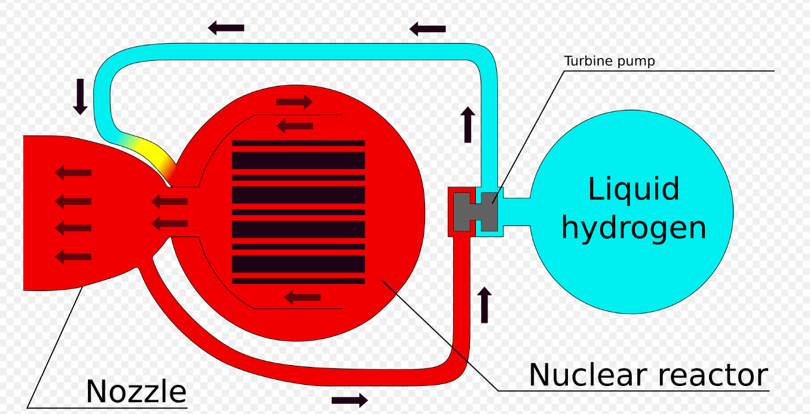
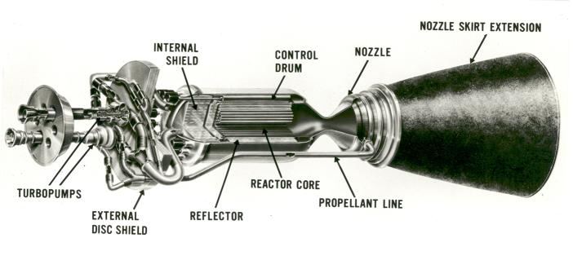
Which Thermal Propulsion Systems exist?
Objective: To develop the basics of thermal propulsion – Group 3
Nuclear thermal propulsion systems
L2 – Propulsion Systems
Space Propulsion ENG-510

Slide 61
Which Thermal Propulsion Systems exist?
Objective: To develop the basics of thermal propulsion – Group 3
Nuclear thermal propulsion systems
NERVA solid core design (tested on ground)
L2 – Propulsion Systems
Space Propulsion ENG-510

Slide 62
Which Thermal Propulsion Systems exist?
Objective: To develop the basics of thermal propulsion – Group 3
Nuclear thermal propulsion systems
Liquid core nuclear reactor fuel
Liquid core nuclear engines are fueled by compounds of fissionable elements in liquid phase
A liquid-core engine is proposed to operate at temperatures above the melting point of solid nuclear fuel and cladding
The higher operating temperatures would be expected to deliver specific impulse performance on the order of 1300 to 1500 s
L2 – Propulsion Systems
Space Propulsion ENG-510

Slide 63
Which Thermal Propulsion Systems exist?
Objective: To develop the basics of thermal propulsion – Group 3
Nuclear thermal propulsion systems
Liquid core nuclear reactor fuel
A liquid-core reactor would be extremely difficult to build with current technology
One major issue is that the reaction time of the nuclear fuel is much longer than the heating time of the working fluid
If the nuclear fuel and working fluid are not physically separated, this means that the fuel must be trapped inside the engine while the working fluid is allowed to easily exit through the nozzle
L2 – Propulsion Systems
Space Propulsion ENG-510

Slide 64
Which Thermal Propulsion Systems exist?
Objective: To develop the basics of thermal propulsion – Group 3
Nuclear thermal propulsion systems
Gas core nuclear reactor fuel
The final fission classification is the gas-core system
This is a modification to the liquid-core design which uses rapid circulation of the fluid to create a torodial pocket of gaseous uranium fuel in the middle of the reactor, surrounded by hydrogen
In this case, the fuel does not touch the reactor wall at all, so temperatures could reach several tens of thousands of degrees, which would allow specific impulses of 3000 to 5000 s
L2 – Propulsion Systems
Space Propulsion ENG-510

Slide 65
Which Thermal Propulsion Systems exist?
Objective: To develop the basics of thermal propulsion – Group 3
Nuclear thermal propulsion systems
Gas core nuclear reactor fuel
In this basic design, the "open cycle", the losses of nuclear fuel would be difficult to control, which has led to studies of the "closed cycle" or where the gaseous nuclear fuel is contained in a super-high-temperature quartz container, over which the hydrogen flows
The closed-cycle engine has much more in common with the solid-core design, but this time is limited by the critical temperature of quartz instead of the fuel and cladding
L2 – Propulsion Systems
Space Propulsion ENG-510

Slide 66
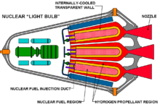
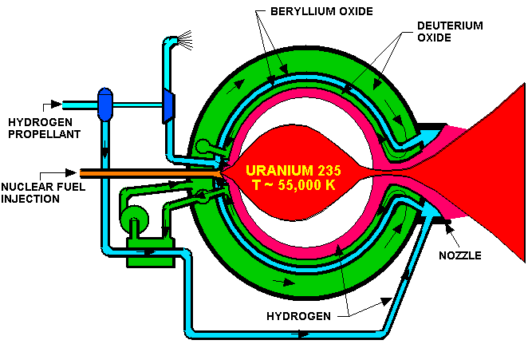
Which Thermal Propulsion Systems exist?
Objective: To develop the basics of thermal propulsion – Group 3
Nuclear thermal propulsion systems
Gas core nuclear reactor fuel
Open Cycle Gas Core
L2 – Propulsion Systems
Space Propulsion ENG-510
Closed Cycle Gas Core

Slide 67
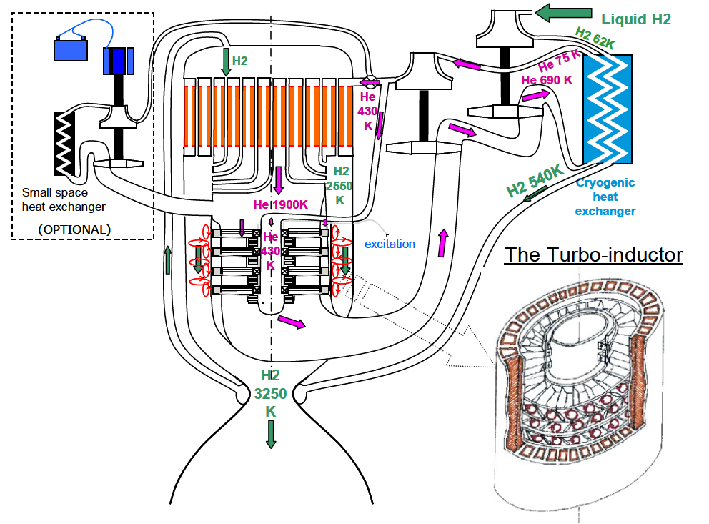
Which Thermal Propulsion Systems exist?
Objective: To develop the basics of thermal propulsion – Group 3
Nuclear thermal propulsion systems
NTER (Nuclear Thermal Electric Rocket) Concept from ESA
Conductive heating of the hydrogen in the subsonic area
L2 – Propulsion Systems
Space Propulsion ENG-510

Slide 68
Which Thermal Propulsion Systems exist?
Objective: To develop the basics of thermal propulsion – Group 3
Nuclear thermal propulsion systems
NTER (Nuclear Thermal Electric Rocket) Concept from ESA
The cryogenic hydrogen is first pumped at high pressure, and then flows through a heat exchanger to be used as cold source for the Brayton cycle
At the exit of the exchanger, the warm hydrogen can optionally provide some cooling to the throat area to protect the throat from excessive heating
At this point the hydrogen enters the nuclear core at a temperature beyond 540K
It is heated by the nuclear core up to an assumed temperature 2550K
Then the hydrogen flows through the longitudinal channels of a turbo-inductor
Its temperature is increased to 3250K by convection
Finally, the hydrogen is exhausted through a nozzle to produce the thrust
L2 – Propulsion Systems
Space Propulsion ENG-510

Slide 69
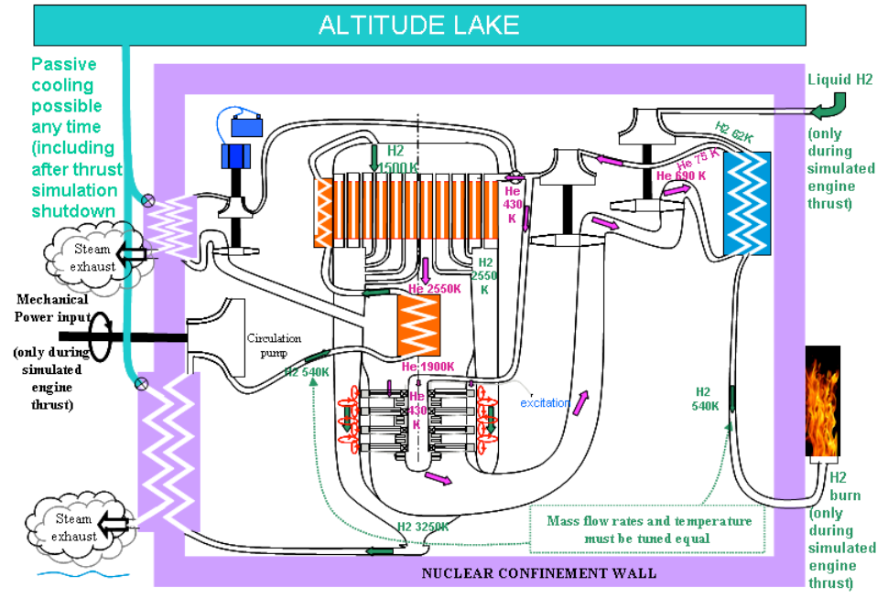
Which Thermal Propulsion Systems exist?
Objective: To develop the basics of thermal propulsion – Group 3
Nuclear thermal propulsion systems
NTER (Nuclear Thermal Electric Rocket) Concept from ESA
Advantages: Testing on ground seems to be possible / safe
L2 – Propulsion Systems
Space Propulsion ENG-510

Slide 70
Which Thermal Propulsion Systems exist?
Objective: To develop the basics of thermal propulsion – Group 3
Nuclear thermal propulsion systems
NTER (Nuclear Thermal Electric Rocket) Concept from ESA
Disadvantages: Very high engine mass
L2 – Propulsion Systems
Space Propulsion ENG-510

Slide 71
Which Thermal Propulsion Systems exist?
Objective: To develop the basics of thermal propulsion – Group 3
Radioisotope thermal propulsion systems
A variant is the radioisotope thermal propulsion system, in which the reaction mass is heated by a radioisotope heat source instead of a nuclear fission reactor
A radioisotope rocket or radioisotope thermal rocket is a type of thermal propulsion system that uses the heat generated by the decay of radioactive elements to heat a working fluid, which is then exhausted through a rocket nozzle to produce thrust
They are similar in nature to nuclear thermal propulsion systems, but are considerably simpler and often have no moving parts
L2 – Propulsion Systems
Space Propulsion ENG-510

Slide 72
Which Thermal Propulsion Systems exist?
Objective: To develop the basics of thermal propulsion – Group 3
Radioisotope thermal propulsion systems
The basic idea is a development of existing radioisotope thermoelectric generator, or RTG, systems, in which the heat generated by decaying nuclear fuel is used to generate power
In the space propulsion the generator is removed, and the working fluid is instead used to produce thrust directly
Temperatures of about 1500 to 2000 °C are possible in this system, allowing for specific impulses of about 700 to 800 s
L2 – Propulsion Systems
Space Propulsion ENG-510

Slide 73
Which Thermal Propulsion Systems exist?
Objective: To develop the basics of thermal propulsion – Group 3
Radioisotope thermal propulsion systems
However the amount of power generated by such systems is typically fairly low
Whereas the full "active" reactor system in a nuclear thermal propulsion system can be expected to generate over a gigawatt, a radioisotope generator might get 5 kW
Another drawback to the use of radioisotopes in rockets is an inability to change the operating power
The radioisotope constantly generates heat that must be safely dissipated when it is not heating a propellant
Reactors, on the other hand, can be throttled or shut down as desired
L2 – Propulsion Systems
Space Propulsion ENG-510

Slide 74
Which Thermal Propulsion Systems exist?
Objective: To develop the basics of thermal propulsion – Group 3
Laser thermal propulsion systems
The laser thermal propulsion system is a thermal propulsion system in which the propellant is heated by energy provided by an external laser beam
The beam heats a solid heat exchanger, which in turn heats an inert liquid propellant, converting it to hot gas which is exhausted through a conventional nozzle
The thermal energy source is a laser, which heats a working fluid in a heat exchanger
L2 – Propulsion Systems
Space Propulsion ENG-510

Slide 75
Which Thermal Propulsion Systems exist?
Objective: To develop the basics of thermal propulsion – Group 3
Laser thermal propulsion systems
Depending on the laser power, a laser thermal propulsion systems can have a thrust-to-weight ratio similar to chemical propulsion systems, while achieving a specific impulse similar to nuclear thermal propulsion systems
There are two main approaches: off-board, where the laser source is external to the spacecraft, and onboard, where the laser is part of the spacecraft's propulsion system
For ground-to-orbit launches, the laser source for such a rocket would be a permanent installation capable of high-frequency launches, while the rockets would only contain inert propellant
L2 – Propulsion Systems
Space Propulsion ENG-510

Slide 76
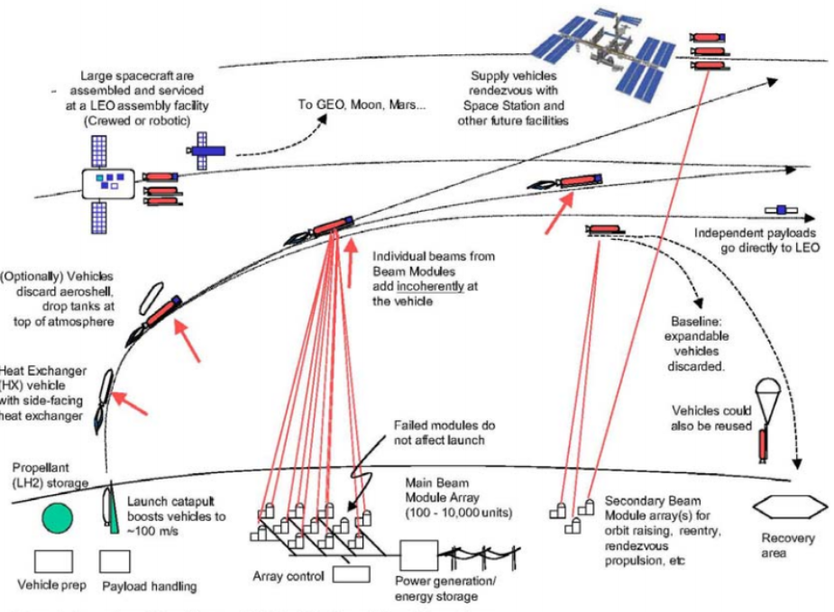
Which Thermal Propulsion Systems exist?
Objective: To develop the basics of thermal propulsion – Group 3
Laser thermal propulsion systems
N
A laser thermal rocket is both a type of beam-powered propulsion and a thermal rocket. The thermal energy source is a laser, which heats a working fluid in a heat exchanger. The working fluid is then expanded through a nozzle to produce thrust. Depending on the laser power, a laser thermal rocket can have a thrust-to-weight ratio similar to chemical rockets, while achieving a specific impulse similar to nuclear thermal rockets.^{[7]} For ground-to-orbit launches, the laser source for such a rocket would be a permanent installation capable of high-frequency launches, while the rockets could contain inert propellant
There are two main approaches: off-board, where the laser source is external to the spacecraft, and onboard, where the laser is part of the spacecraft's propulsion system.
L2 – Propulsion Systems
Space Propulsion ENG-510

Slide 77
Which Thermal Propulsion Systems exist?
Objective: To develop the basics of thermal propulsion – Group 3
Microwave thermal propulsion systems
A microwave thermal propulsion system is similar to a laser thermal propulsion system, except that it is powered by a microwave source, for example a ground-based phased array
Relative to lasers, the main advantage of using microwaves is that sources currently cost 1 to 3 orders of magnitude less per Watt
The main disadvantage is that the microwave beam director needs to have a much larger diameter than a laser beam director due to beam diffraction effects
L2 – Propulsion Systems
Space Propulsion ENG-510

Slide 78
Which Thermal Propulsion Systems exist?
Objective: To develop the basics of thermal propulsion – Group 3
Microwave thermal propulsion systems
In microwave thermal propulsion, an external microwave beam is used to heat a refractory heat exchanger to > 1500 K, heating a propellant such as hydrogen, methane, or ammonia
This improves the propulsion system's specific impulse and thrust/weight ratio relative to conventional rocket propulsion
For example, hydrogen can provide a specific impulse of 700–900 seconds and a thrust/weight ratio of 50-150
L2 – Propulsion Systems
Space Propulsion ENG-510

Slide 79
Which Chemical Propulsion Systems exist?
Objective: To develop the basics of chemical propulsion
Thermal Propulsion Systems
Material Ejection
L3 – Propulsion Systems
Space Propulsion
Space Propulsion ENG-510
Chemical Propulsion Systems
Non-Material Ejection
Electrical Propulsion Systems

Slide 80
Which Chemical Propulsion Systems exist?
Gaseous propulsion systems
Liquid propulsion systems
Objective: To develop the basics of chemical propulsion
Gelled propulsion systems
Combustion
Hybrid propulsion systems
L3 – Propulsion Systems
Chemical Propulsion Systems
Space Propulsion ENG-510
Solid propulsion systems
Rotation Detonation Engine
Detonation
Pulse Detonation Engine

Slide 81
Which Chemical Propulsion Systems exist?
Objective: To develop the basics of chemical propulsion
Chemical Propulsion Systems
Gaseous propulsion systems
Liquid propulsion systems
Gelled propulsion systems
Solid propulsion systems
Hybrid (liquid / solid) propulsion systems
L3 – Propulsion Systems
Space Propulsion ENG-510

Slide 82
Which Chemical Propulsion Systems exist?
Propellant Phase in Tanks
Solid
Liquid
Gas
Bi-prop Thruster
Bipropellant Thruster
Double base or composite
LOx / LH2 – LOx / LCH4 – MON / MMH – HTP / Ethanol
GOx / GCH4
Objective: To develop the basics of chemical propulsion
Chemical Propulsion Systems
Gaseous propulsion systems
Liquid propulsion systems
Gelled propulsion systems
Solid propulsion systems
Hybrid (liquid / solid) propulsion systems
Combustion
Gelled
Liquid Thruster
Solid / Liquid
Hybrid Thruster Bi-prop
L3 – Propulsion Systems
Space Propulsion ENG-510
Chemical Reaction
HTP / IPA
Decomp
Hydrazine (N2H4) HTP (H2O2) ADN
Monopropellant Thruster
No

Slide 83
Which Chemical Propulsion Systems exist?
Objective: To develop the basics of chemical propulsion
Chemical Propulsion Systems
Chemical Energy by chemical reaction
Mass flow control by a nozzle throat
Kinetic Energy
L3 – Propulsion Systems
Space Propulsion ENG-510
Energy
Impulse
Pressure + temperature increase

Slide 84
Which Chemical Propulsion Systems exist?
Objective: To develop the basics of chemical propulsion
Chemical Propulsion Systems
Pressurization System
L3 – Propulsion Systems
Space Propulsion ENG-510

Slide 85
Which Chemical Propulsion Systems exist?
Objective: To develop the basics of chemical propulsion
Chemical Propulsion Systems
Propellant (reactant): O2, N2O4, H2O2, HNO3, NO2, H2, C𝑥H𝑦, N2H4, HNO3, NH4, NO2, …
Propellant state: Cryogenic, green (non-toxic), storable (liquid in a room T), …
Propellant phase (at storage or at injection…): Solid, liquid, gas
Chemical reaction: Combustion, exothermic decomposition, …
Pressure feeding method: Blow-down, regulator, Turbopump, …
Cooling method: Regenerative cooling, ablative cooling, film cooling, radiative cooling, …
Usage: Launch, upper stage, apogee kick, orbit insertion, etc
L3 – Propulsion Systems
Space Propulsion ENG-510

Slide 86
Propellant Phase in Tanks
Solid
Liquid
Gas
Water Propulsion
The ultimate
green propellant
GOx / GH2
Combustion
GOx / GCH4
NOx / Ethane
Chemical Reaction
2-phase condition or supercritical condition
Decomp
No

Slide 87
Which Chemical Gaseous Propulsion Systems exist?
Objective: To develop the basics of chemical gaseous propulsion
Characteristics of Gas / Gas Combustion Propulsion Systems:
Gaseous propulsion systems with Water propulsion as the ultimate green propellant?
L3 – Propulsion Systems
Space Propulsion ENG-510

Slide 88
Which Chemical Gaseous Propulsion Systems exist?
Objective: To develop the basics of chemical gaseous propulsion
Characteristics of Gas / Gas Combustion Propulsion Systems:
High system complexity (combustion involved and Electrolyzer needed)
Acceptable Δv
Extremely safe operation
No contamination from exhaust (combustion) gases
Low thrust
Fuel cell could be added for Energy storage
Combination with ECLSS – Life Support System
L3 – Propulsion Systems
Space Propulsion ENG-510

Slide 89
Which Chemical Gaseous Propulsion Systems exist?
Objective: To develop the basics of chemical gaseous propulsion
Architecture of Gas / Gas Combustion Propulsion Systems:
GOx Tank
L3 – Propulsion Systems
Valve
Space Propulsion ENG-510
Water Tank
Exhaust
Electrolyzer
Valve
E
GH2 Tank

Slide 90
Which Chemical Gaseous Propulsion Systems exist?
Objective: To develop the basics of chemical gaseous propulsion
Architecture of Gas / Gas Combustion Propulsion Systems:
Propellant is stored as liquid
Electrolyzer uses electrical energy as provided by S/C in order to generate GOx and GH2
3 tanks are needed for Water propulsion system
L3 – Propulsion Systems
Space Propulsion ENG-510

Slide 91
Which Chemical Gaseous Propulsion Systems exist?
Objective: To develop the basics of chemical gaseous propulsion
REACH (no progress since a long time…): Registration, Evaluation and Authorization of Chemicals
L3 – Propulsion Systems
Space Propulsion ENG-510

Slide 92
Which Chemical Gaseous Propulsion Systems exist?
Objective: To develop the basics of chemical gaseous propulsion
Chemical propulsion systems applications and green replacement candidates
L3 – Propulsion Systems
Space Propulsion ENG-510

Slide 93
Which Chemical Gaseous Propulsion Systems exist?
Objective: To develop the basics of chemical gaseous propulsion
L3 – Propulsion Systems
Space Propulsion ENG-510

Slide 94
Which Chemical Gaseous Propulsion Systems exist?
Objective: To develop the basics of chemical gaseous propulsion
Water Propulsion
Is defined as propulsion with propellants that are produced in Space from water via an electrolyzer
Is a semi electric propulsion where propellant generation (over a long time at low power) and usage (high thrust during a short period) is decoupled
Water is stored at low pressure in a conventional tank; gases are generated in orbit
Combined with a fuel cell it can even be used as a highly efficient battery
L3 – Propulsion Systems
Space Propulsion ENG-510

Slide 95
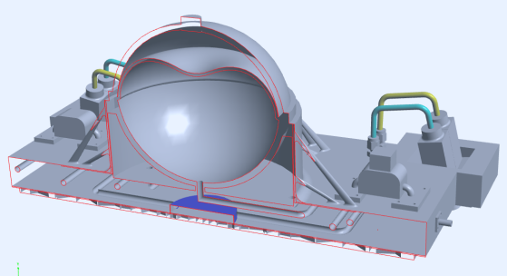
Which Chemical Gaseous Propulsion Systems exist?
Objective: To develop the basics of chemical gaseous propulsion
Water Propulsion
Functional scheme:
L3 – Propulsion Systems
Space Propulsion ENG-510
Fully integrated System
for small satellites

Slide 96
Which Chemical Gaseous Propulsion Systems exist?
Objective: To develop the basics of chemical gaseous propulsion
Water Propulsion
Operational mode:
L3 – Propulsion Systems
Electric Power → Charging of Gas Tanks
Space Propulsion ENG-510
Start
Gas Tanks (partly) empty
Next cycle
Gas Tanks full
Thruster Operation → Generation of Impulse
(Fuel cell operation → Generation of electric Power)

Slide 97
Which Chemical Gaseous Propulsion Systems exist?
Objective: To develop the basics of chemical gaseous propulsion
Water Propulsion
Operation mode of the system is in cycles between gas generation and usage
Functioning sequence of the subsystem:
After the start the water feed is switched ON: water from the water tank is fed via low pressure into the electrolyzer
GOX and GH2 are produced in the electrolyzer via electric power with a high pressure
After production the propellants are stored in gas tanks and are ready for use (gas tanks full)
The gases are used in the thrusters to generate thrust. Optional they can be used in a fuel cell to generate electric power
When the gas tanks are empty the process starts again (back to step 1)
L3 – Propulsion Systems
Space Propulsion ENG-510

Slide 98
Which Chemical Gaseous Propulsion Systems exist?
Objective: To develop the basics of chemical gaseous propulsion
Water Propulsion
Water tank size is driven by the total impulse requirement and a Thruster ISP of 320 s
Gas tank size is driven by the required propellant mass per individual maneuver (cycle)
Electrolyzer power is driven by the required propellant mass per individual maneuver (cycle) and the available / allowed charge time
L3 – Propulsion Systems
Space Propulsion ENG-510

Slide 99
Which Chemical Gaseous Propulsion Systems exist?
Objective: To develop the basics of chemical gaseous propulsion
Water Propulsion
System sizing parameter:
L3 – Propulsion Systems
Space Propulsion ENG-510

Slide 100
Which Chemical Gaseous Propulsion Systems exist?
Objective: To develop the basics of chemical gaseous propulsion
Water Propulsion versus Conventional System
Example: Earth Care mission
System Architecture
4 x 5 N thrusters
Total Propellant: 240 - 310 kg Hydrazine
L3 – Propulsion Systems
Space Propulsion ENG-510

Slide 101
Which Chemical Gaseous Propulsion Systems exist?
Objective: To develop the basics of chemical gaseous propulsion
Mission Analysis
Maximum impulse per sequence, derived from provided sample data: 5627 Ns
2.6 kg Hydrazine, or 1.9 kg Water (based on Isp = 300 s)
Amount needs to be available before next re-filling sequence could be started
Derived Water Propulsion System Architecture
GH2 – Tank: 52 ltr
GO2 – Tank: 26 ltr
Water Tank: 228 kg => 285 ltr Tank @ 5:1 Blow-down ratio
L3 – Propulsion Systems
Space Propulsion ENG-510

Slide 102
Which Chemical Gaseous Propulsion Systems exist?
Objective: To develop the basics of chemical gaseous propulsion
Electrical Power Supply
Theoretical possible (with satellite design changes): 350 W during sun, 150 W during Eclipse (Remark: Electrolyzer output not scalable, only on / off! Two cells required)
Rough estimation for preliminary design: 200 W
Orbit Data: 95 minutes total, 40 minutes in sun, 55 minutes in eclipse
L3 – Propulsion Systems
Space Propulsion ENG-510

Slide 103
Which Chemical Gaseous Propulsion Systems exist?
Objective: To develop the basics of chemical gaseous propulsion
Example: Earth Care mission – Tank size
L3 – Propulsion Systems
Space Propulsion ENG-510

Slide 104
Which Chemical Gaseous Propulsion Systems exist?
Objective: To develop the basics of chemical gaseous propulsion
Example: Earth Care mission – Charge time
L3 – Propulsion Systems
Space Propulsion ENG-510

Slide 105
Which Chemical Gaseous Propulsion Systems exist?
Objective: To develop the basics of chemical gaseous propulsion
Example: Earth Care mission – Charge time versus available power
L3 – Propulsion Systems
Space Propulsion ENG-510

Slide 106
Which Chemical Gaseous Propulsion Systems exist?
Objective: To develop the basics of chemical gaseous propulsion
Example: Earth Care mission – Gas tank volume versus impulse
L3 – Propulsion Systems
Space Propulsion ENG-510

Slide 107
Which Chemical Gaseous Propulsion Systems exist?
Objective: To develop the basics of chemical gaseous propulsion
Water Propulsion
Test status:
L3 – Propulsion Systems
Space Propulsion ENG-510

Slide 108
Which Chemical Gaseous Propulsion Systems exist?
Objective: To develop the basics of chemical gaseous propulsion
Water Propulsion
Test status:
L3 – Propulsion Systems
Space Propulsion ENG-510

Slide 109
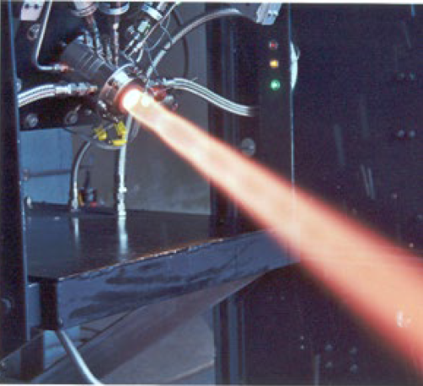
Which Chemical Gaseous Propulsion Systems exist?
Objective: To develop the basics of chemical gaseous propulsion
Water Propulsion
Example: Sierra Space
L3 – Propulsion Systems
Space Propulsion ENG-510

Slide 110
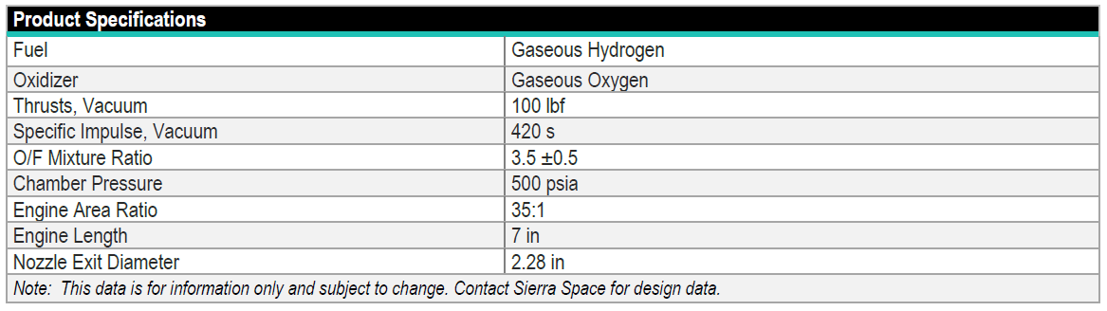
Which Chemical Gaseous Propulsion Systems exist?
Objective: To develop the basics of chemical gaseous propulsion
Water Propulsion
Example: Sierra Space
L3 – Propulsion Systems
Space Propulsion ENG-510

Slide 111
Which Chemical Gaseous Propulsion Systems exist?
Objective: To develop the basics of chemical gaseous propulsion
Water Propulsion
High performance (high Isp)
Low cost, green propellant without any potential limitations in future
Can be preloaded at manufacturer
High gas pressure is only generated when electrical power is applied – safe
If combined with fuel cell it can even be used as battery
Existing COTS components can be used
L3 – Propulsion Systems
Space Propulsion ENG-510

Slide 112
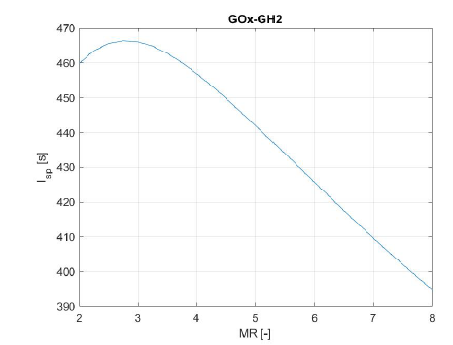
Which Chemical Gaseous Propulsion Systems exist?
Objective: To develop the basics of chemical gaseous propulsion
Water Propulsion
But higher system complexity due to additional elements like electrolyzer or compressor
Thruster requires high temperature combustion chamber material
Usage only possible in cycle mode
L3 – Propulsion Systems
Space Propulsion ENG-510

Slide 113
Which Chemical Gaseous Propulsion Systems exist?
Objective: To develop the basics of chemical gaseous propulsion
Example: NASA satellite with Water propulsion system
A NASA CubeSat will launch into low-Earth orbit to demonstrate a new type of propulsion system
Carrying a pint of liquid water as fuel, the system will split the water into hydrogen and oxygen in space and burn them in a tiny rocket engine for thrust
Hydros hardware unit is a water-based propulsion system, sized for CubeSats
The system uses electricity to produce gas propellants – hydrogen and oxygen – from liquid water and burns these gases in a rocket nozzle to generate thrust
Hydros was developed by Tethers Unlimited
L3 – Propulsion Systems
Space Propulsion ENG-510

Slide 114
Which Chemical Gaseous Propulsion Systems exist?
Objective: To develop the basics of chemical gaseous propulsion
Other Gaseous Propulsion Systems
GOX / GCH4 (seems to be very interesting considering number of launch vehicles with LOX / LCH4 propellant
NOx / Propylene self-pressurization propellants
L3 – Propulsion Systems
Space Propulsion ENG-510

Slide 115
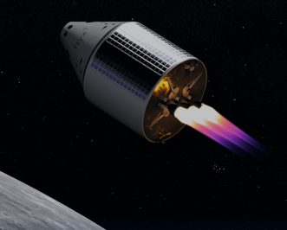
Which Chemical Gaseous Propulsion Systems exist?
Objective: To develop the basics of chemical gaseous propulsion
Example: TEC Nyx Moon capsule
Nyx Moon capsule from The Exploration Company considers LOx / LCH4 thruster as main propulsion system
Cryogenic liquid propellants will boil-off during the mission
L3 – Propulsion Systems
Space Propulsion ENG-510

Slide 116
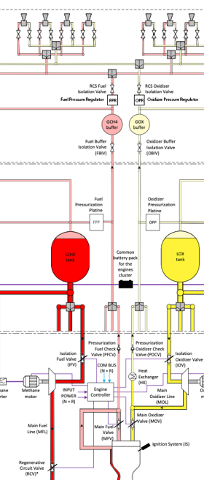
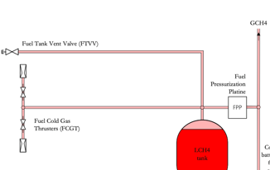
Which Chemical Gaseous Propulsion Systems exist?
Objective: To develop the basics of chemical gaseous propulsion
Example: TEC Nyx Moon capsule
GOx / GCH4 generated during the mission could be used as attitude control system
L3 – Propulsion Systems
Space Propulsion ENG-510

Slide 117
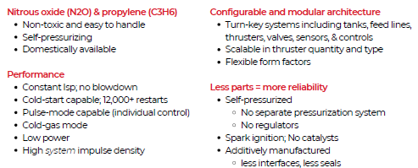
Which Chemical Gaseous Propulsion Systems exist?
Objective: To develop the basics of chemical gaseous propulsion
Example: Dawn Aerospace green bi-propellant propulsion system
Self-pressurization propellants are considered
L3 – Propulsion Systems
Space Propulsion ENG-510

Slide 118
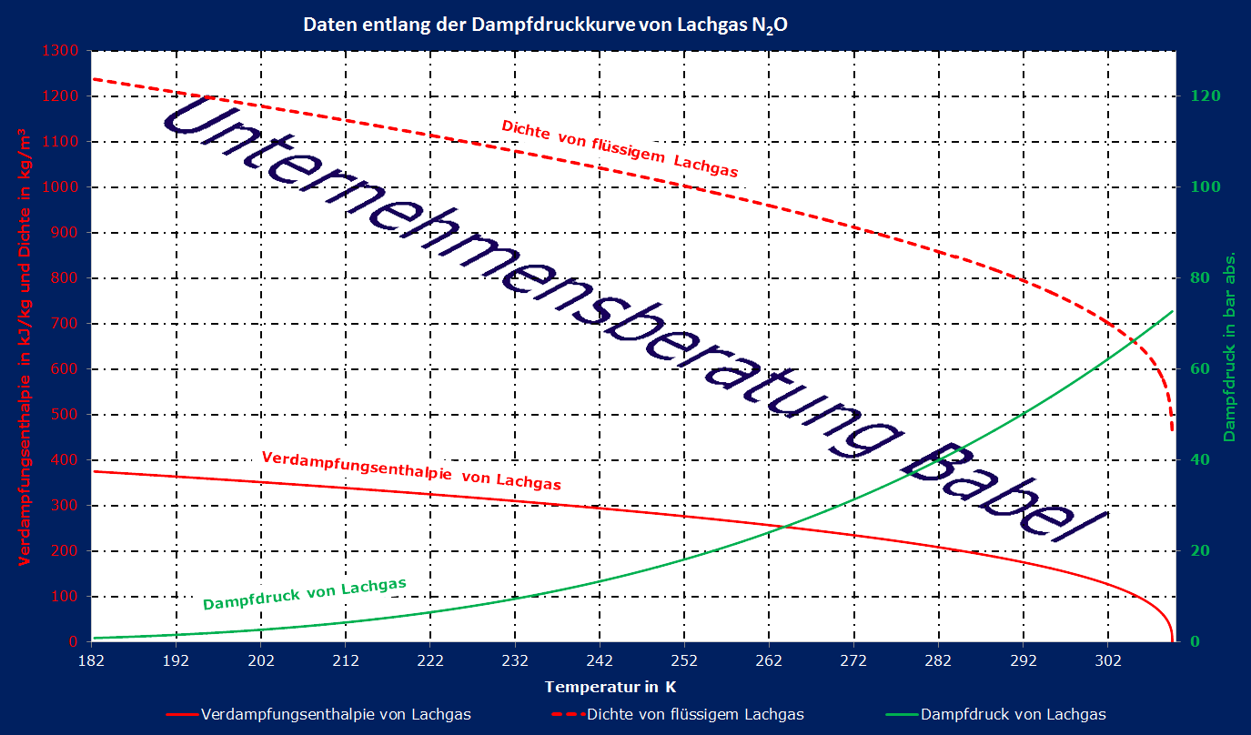
Which Chemical Gaseous Propulsion Systems exist?
Objective: To develop the basics of chemical gaseous propulsion
Characteristics of Gas / Gas Combustion Propulsion Systems:
B
L3 – Propulsion Systems
Space Propulsion ENG-510

Slide 119
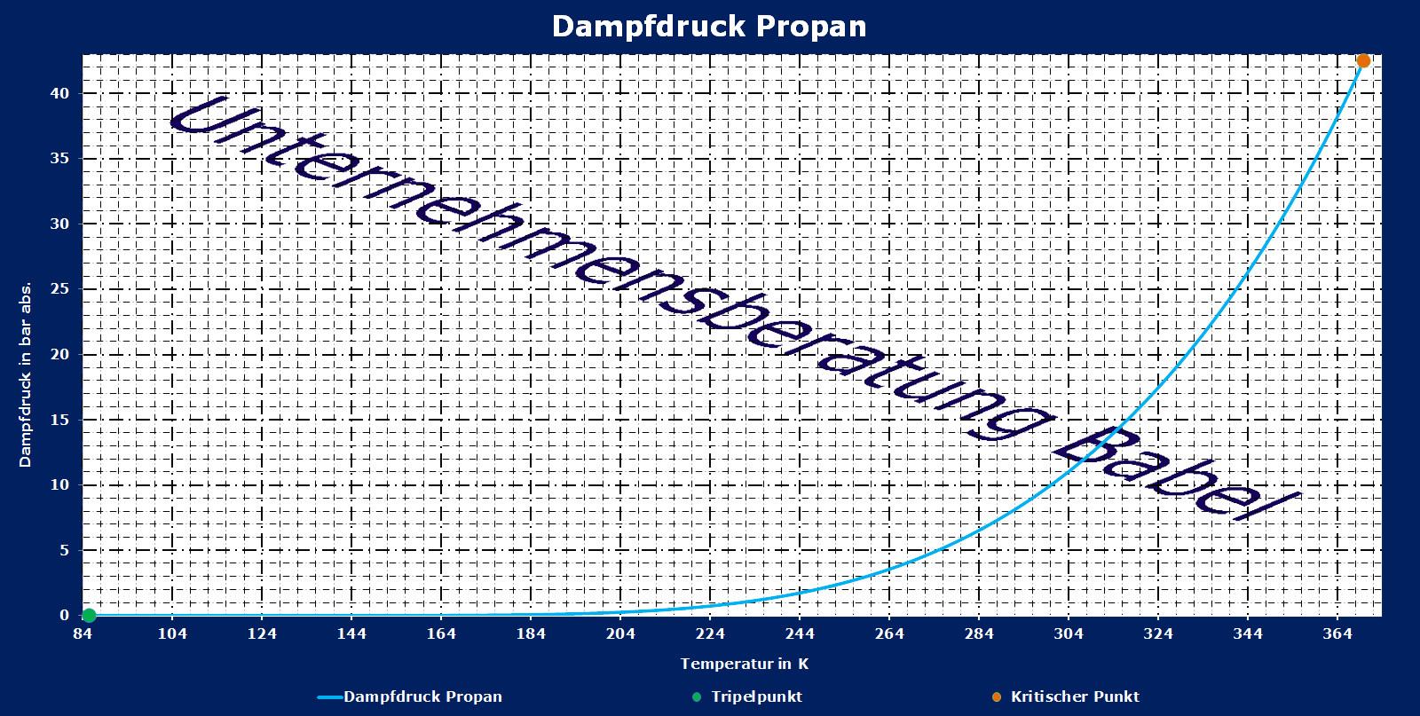
Which Chemical Gaseous Propulsion Systems exist?
Objective: To develop the basics of chemical gaseous propulsion :
B
L3 – Propulsion Systems
Space Propulsion ENG-510

Slide 120
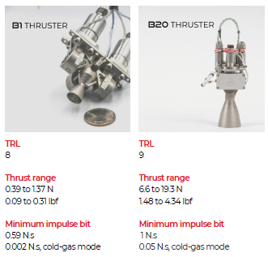
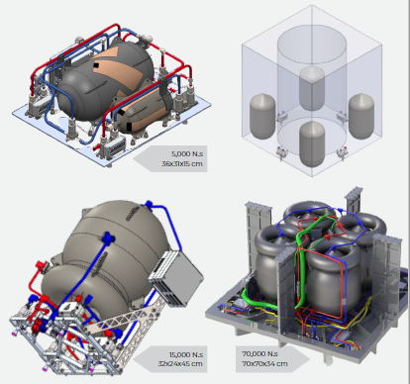
Which Chemical Gaseous Propulsion Systems exist?
Objective: To develop the basics of chemical gaseous propulsion
Example: Dawn Aerospace green bi-propellant propulsion system
L3 – Propulsion Systems
Space Propulsion ENG-510

Slide 121
Which Chemical Gaseous Propulsion Systems exist?
Objective: To develop the basics of chemical gaseous propulsion
Example: Dawn Aerospace green bi-propellant propulsion system
Propellant tanks must support high pressure levels
Long duration burns must be compatible with vaporization rate
Potentially heaters are needed for propellant tanks in order to improve vaporization rate
Gaseous feed to thruster must be ensured
Cooling of thruster might be more difficult
L3 – Propulsion Systems
Space Propulsion ENG-510

Slide 122
Which Chemical Gaseous Propulsion Systems exist?
Objective: To develop the basics of chemical gaseous propulsion
Example: Dawn Aerospace green bi-propellant propulsion system
But results in advantages linked to on-orbit refueling as well as sloshing limitation (in supercritical phase) important for de-orbiting kit
L3 – Propulsion Systems
Space Propulsion ENG-510

Slide 123
Lecture # 3 Introduction & General Course Information
Brief information on your lecturer and the space propulsion course

Slide 124
Potential Special Events
Proposals:
In May:
Visit of EPFL rocket team test facility (e.g. on the Wednesday after the launch event, May 28)
In May:
External lecturer with highlight lecture out of EPFL plasma center
Topic: PhD on electric thrusters in VLEO + test possibilities in the plasma center
Date: May 20
L3 - Introduction
Space Propulsion ENG-510

Slide 125
Student Feedback
What are your expectations?
Feedback:
From Monday 17 March until midnight Sunday 23 March, the teacher will have an opportunity to get feedback from students on your Bachelor, Master, CMS and MAN courses through the Indicative Student Feedback on Teaching
Please use it!
L3 - Introduction
Space Propulsion ENG-510

